Slide 1
Power BI Embedded
FSI CSU SWARM

Slide 2
Getting Started

Slide 3
Abstract and learning objectives
This Module will register an Application with Power BI and Grant the Application Permissions

Slide 4
Register an Azure AD App to use with Power BI
You register your application with Azure AD to allow your application access to the Power BI REST APIs. Once you register your application, you can establish an identity for your application and specify permissions to Power BI REST resources.
Important
Before you register a Power BI app you need an Azure Active Directory tenant and an organizational user. If you haven't signed up for Power BI with a user in your tenant, the app registration doesn't complete successfully.

Slide 5
Prerequisite: Azure AD
If not already created, ensure you have set up your own Azure Active Directory (Azure AD) tenant.

Slide 6
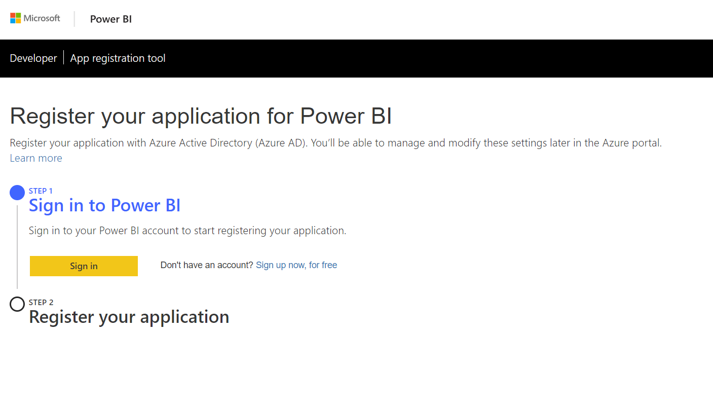
Power BI Application Registration Tool
Sign in to Power BI’s developer portal to register your application
https://dev.powerbi.com/apps

Slide 7
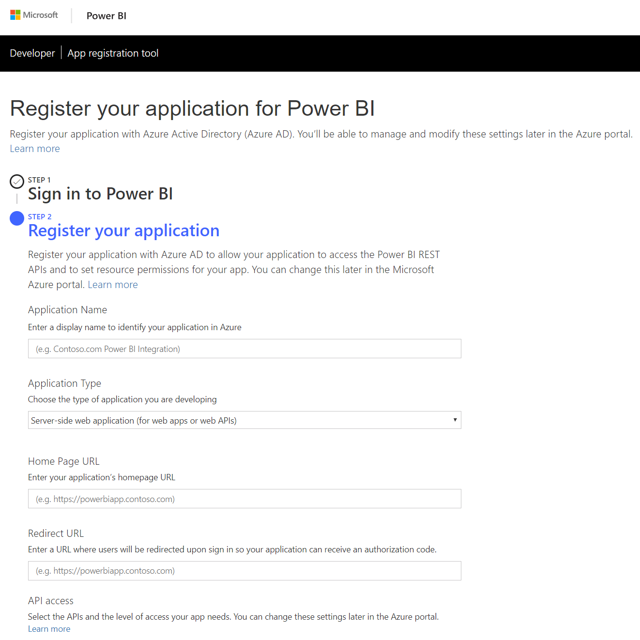
Power BI Application Registration Tool
Register your app by filling in the required fields
Remember the values for Application Name and Client ID
Example Client ID : 7114bf2f-8aad-49ad-8a7c-2e80e9b6fbba
Application Type | Purpose
Native | You plan on creating an application that is designed for your customers using a master user account (a Power BI Pro license used for signing in to Power BI) to authenticate.
Server-side web application: | You plan on creating an application designed for your organization. You plan on creating an application designed for your customers using service principal to authenticate. You plan on creating web apps or web APIs.

Slide 8
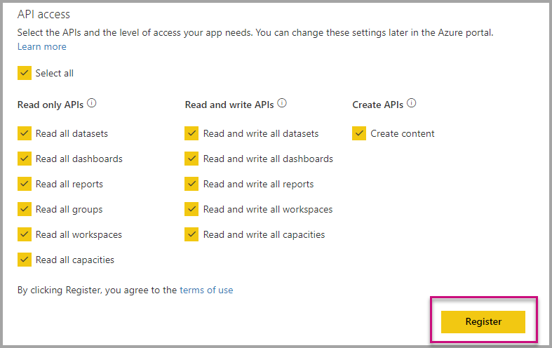
Power BI Application Registration Tool
Choose the Power BI APIs that your application needs.
For more information about Power BI access permissions, see Power BI Permissions.
Then select Register.
Important
If you enable service principals to be used with Power BI, the Azure Active Directory permissions don't take effect anymore. The permissions are managed through the Power BI admin portal.

Slide 9
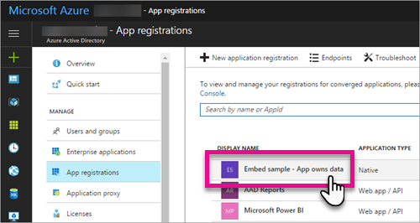
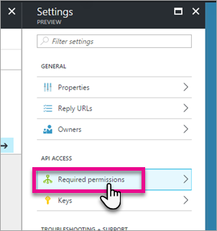
Apply permissions to your App within Azure AD
Enable additional permissions to your application in addition to what the app registration page provides. You can accomplish this task through the Azure AD portal
Browse to App registrations within the Azure portal and select the app that you're using for embedding.
Select Required permissions under API Access.

Slide 10
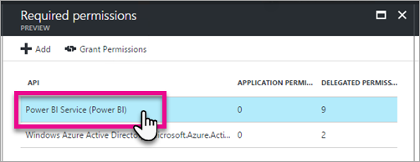
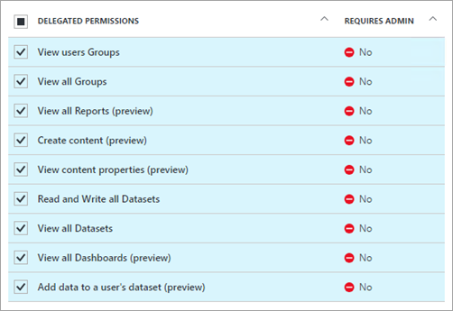
Apply permissions to your App within Azure AD
Enable additional permissions to your application in addition to what the app registration page provides. You can accomplish this task through the Azure AD portal
Within Required permissions, select Power BI Service (Power BI).
Select all permissions under Delegated Permissions. Select them one by one to save the selections. Select Save when done.

Slide 11
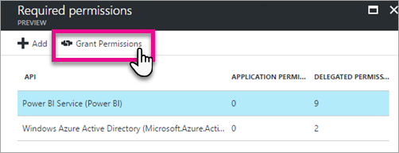
Apply permissions to your App within Azure AD
Enable additional permissions to your application in addition to what the app registration page provides. You can accomplish this task through the Azure AD portal
Within Required permissions, select Grant Permissions.
The Grant Permissions action needs for the master account to avoid being prompted for consent by Azure AD. If the account performing this action is a Global Admin, you grant permissions to all users within your organization for this application. If the account performing this action is the master account and isn't a Global Admin, you grant permissions only to the master accountfor this application.

Slide 12
Wrap Up

